Slide 1
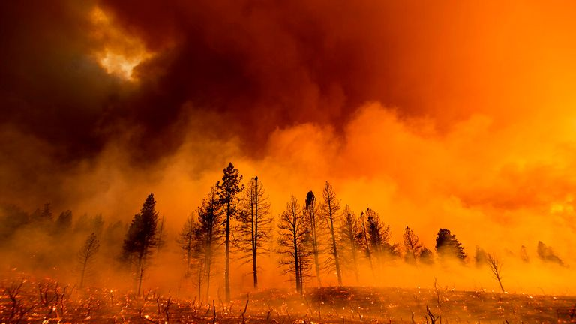
DETECTION OF FIRE COMBUSTION IN FOREST USING IBM WATSON STUDIO
DONE BY:
UTKARSH PARIVESH BOHRA
MANIPAL ACADEMY OF HIGHER EDUCATION DUBAI CAMPUS

Slide 2
Index
Introduction
Purpose
Training The Model
Testing The Model
Application
Future Scope
Conclusion

Slide 3
Introduction
Forest fires are occuring throughout the year with an increasing intensity in the summer and autumn season and usually causes devastating damage to both nature and human.Forest fires are mainly caused by human actions, lightning strikes, spontaneous combustion of dried leaves or saw dust, etc. and are considered as a main contribution to the air pollution. To fight forest fires different solutions were employed throughout the years were primarily aimed at early detection of fires.
The constant evaluation of information and communication technology has led to the introduction of a new generation of solution for early detection and prevention of forest fires like Deployment of Machine Learning model using IBM Watson studio , Application of Convolution Neural Network.

Slide 4
Purpose
Recently, forest fire disaster are getting much attention throughout the world. Significant causes of forest fires are either human origin or environment origin.
The constant evaluation of information and communication technology has led to the introduction of a new generation of solution for early detection and prevention of forest fires like Deployment of Machine Learning model using IBM Watson studio and Application of Convolution Neural Network.
Implementation of these above mentioned solution will help in early detection of forest fire throughout the world and hence preventing them from spreading further.

Slide 5
Training the Model
For training the model I used tensorflow, keras libraries.
I also used activation function like relu, sigmoid .
I have trained my model for 25 times (epochs)

Slide 6
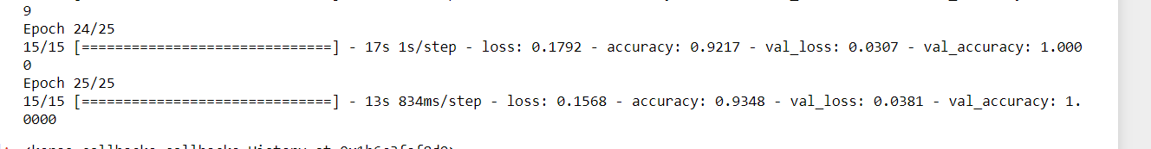
Testing the Model
I have tested my model on my system and results are as follows:
The testing showed 100% accuracy

Slide 7
Application
The main application of this model is to predict the provided image is having forest fire or not. It is well trained so that it will predict the correct data.

Slide 8
Future Scope
Artificial Intelligence and Machine Learning can be used to detect forest fires with the focus on day time images and can also identify smoke and flame immediately and thus reducing false positive and time until the fire fighters are called onto the scene.

Slide 9
Conclusion
In this project I have used Jupiter notebook, Anaconda prompt, IBM Watson Studio for training and deployment of my model . IBM supports technology and efforts to improve forest fire responses.
Without pre-trained Keras model, the train accuracy is 91.5% and validation accuracy is
90%.The validation result had a best figure of 93.48% as accuracy.It is observed that
without using pre-trained Keras model, although the training accuracy is >90%, the overall
accuracy is low unlike where pre-trained model is used.

Slide 10
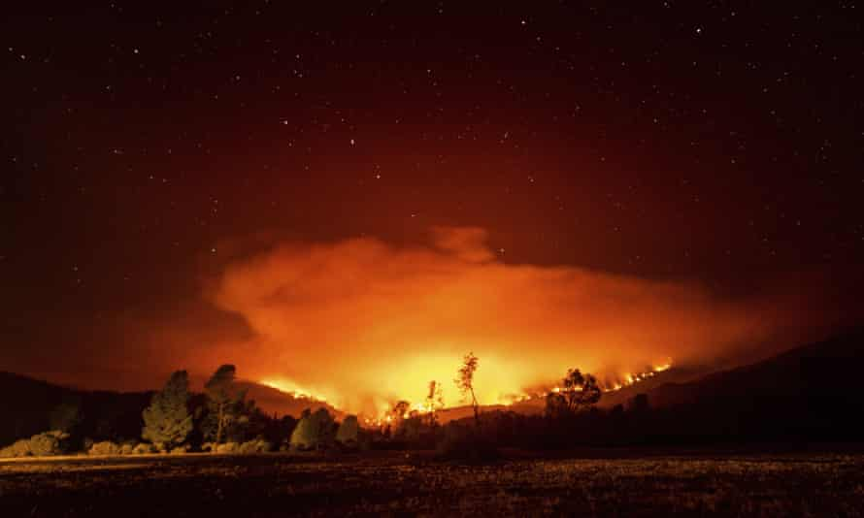
Thank you

